Slide 1
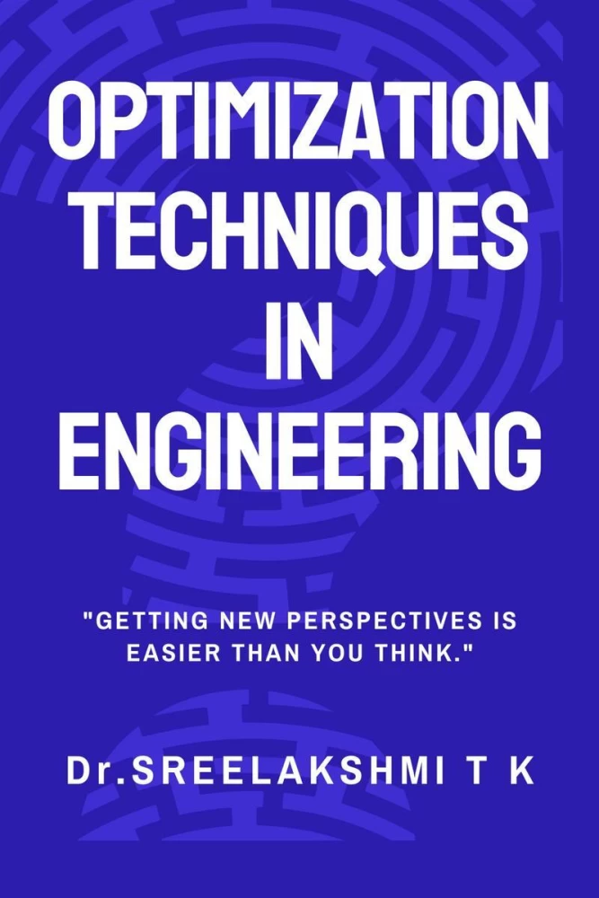
Adaptive Hybrid Optimization Technique Combining Newton-Raphson and Gradient Descent
Abdullah Alshami - 412117701
Kareem Maged – 412117553
Suliman alfowzan 412111550
Insructor: Dr.Ali Mustafa
CS348

Slide 2

This presentation explores an innovative Adaptive Hybrid Optimization Technique that combines the powerful capabilities of the Newton- Raphson and Gradient Descent methods. This hybrid approach harnesses the strengths of both techniques to achieve superior optimization performance.

Slide 3
Introduction to Adaptive Hybrid Optimization Technique
The field of optimization often encounters challenges, particularly when conventional methods face limitations due to issues like non-invertibility of the Hessian matrix.
This project develops an adaptive algorithm that merges the rapid convergence of Newton-Raphson with the reliability of gradient descent.
This hybrid approach proves especially effective when handling problematic Hessians, thereby enhancing the robustness and applicability of optimization techniques in complex scenarios.

Slide 4

Problem Identification
In many optimization tasks, some times the Hessian matrix become non-invertible, posing significant challenges to applying Newton-Raphson's method effectively. Non-invertible Hessians, characterized by a zero determinant, make the update step in Newton-Raphson undefined and can halt the optimization process.
⎡1 2 3 ⎤
⎣2 0 4 ⎤
⎣3 4 5 ⎦ ​​
What is Q^-1 ?

Slide 5

Solution Strategy
The strategy includes a real-time check for the invertibility of the Hessian matrix at each iteration of the optimization process. By calculating the determinant, the algorithm can quickly determine the condition of the Hessian and switch to gradient descent if necessary, thereby preventing potential failures.

Slide 6


Mathematical Foundation of the Solution
Our solution adapts the Newton-Raphson method to overcome the limitations posed by singular Hessians. The update rule is defined as follows:
Where Q^-1 is the inverse of the Hessian matrix, computed as long as the determinant `det(Q)` is non-zero. If `det(Q) = 0`, indicating non-invertibility, the algorithm switches to a gradient descent step:
xn_new = xn - learning_rate * grad
This adaptive mechanism ensures that the optimization continues smoothly without interruption.

Slide 7
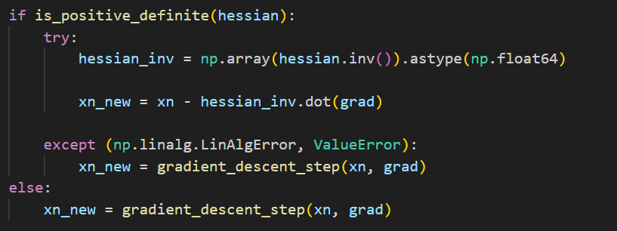
Implementation
Implemented using Python’s sympy library for symbolic computation, the determinant of the Hessian is dynamically evaluated. If the determinant is non-zero, the Newton-Raphson step is executed. If zero, it defaults to a gradient descent step, with a small positive scalar parameter `α` as the learning rate. Below is a snippet of the implementation:
if is_positive_definite(hessian):
try:
hessian_inv = np.array(hessian.inv()).astype(np.float64)
xn_new = xn - hessian_inv.dot(grad)
except (np.linalg.LinAlgError, ValueError):
xn_new = gradient_descent_step(xn, grad)
else:
xn_new = gradient_descent_step(xn, grad)
xn = xn_new

Slide 8
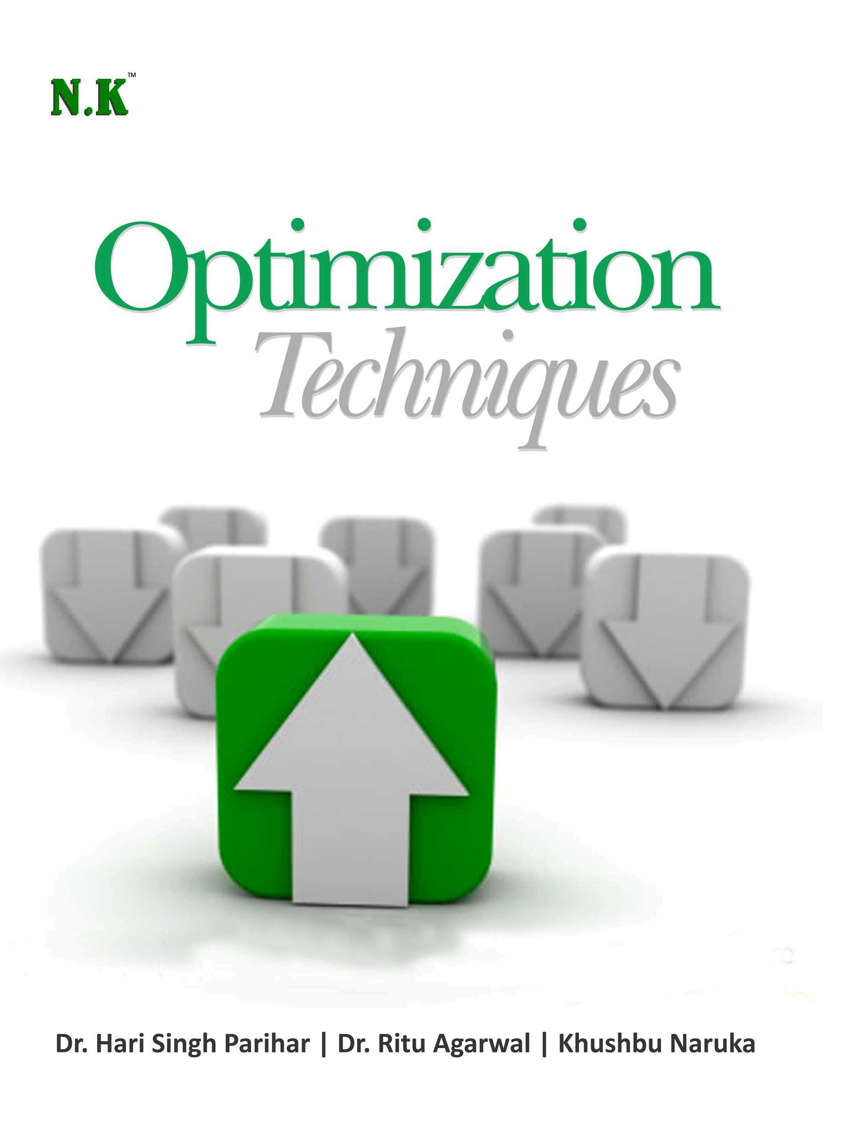
Results and Discussion
The hybrid method was applied to various test functions, showing significant improvements in convergence stability compared to traditional methods. The adaptive technique excelled particularly in scenarios with complex landscapes and at points where Hessians were non-invertible.

Slide 9
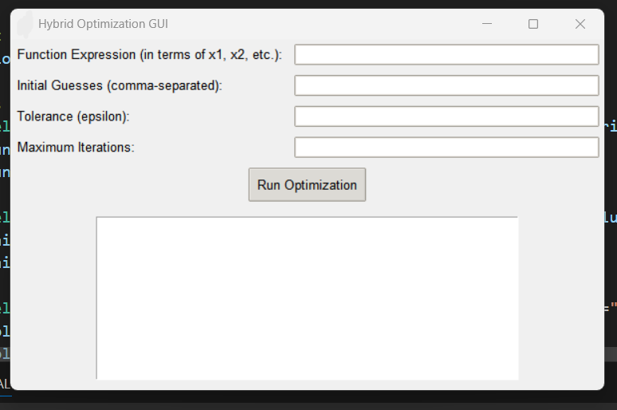
Our program

Slide 10
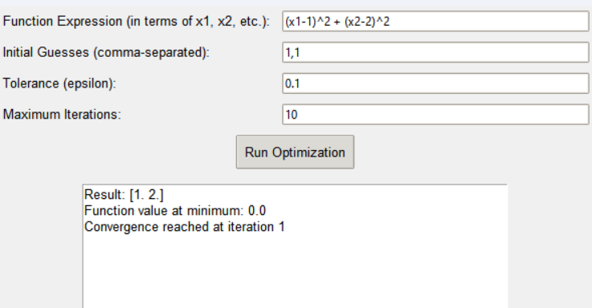
Result

Slide 11
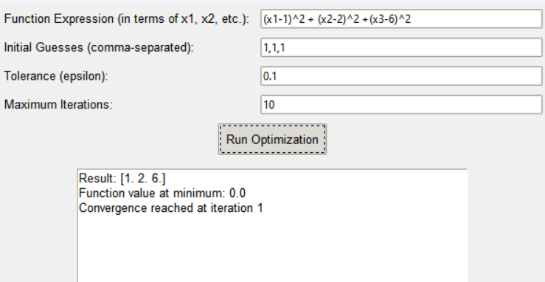

Slide 12
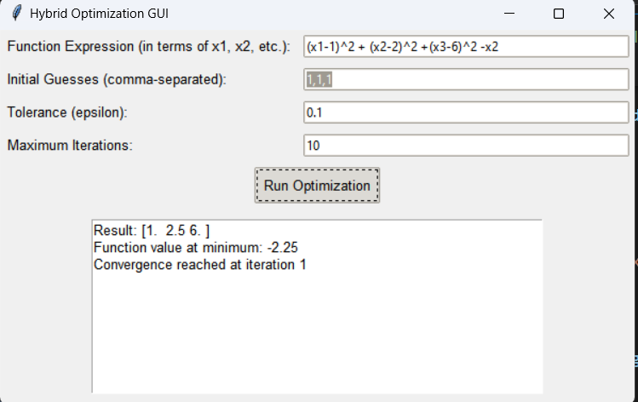

Slide 13
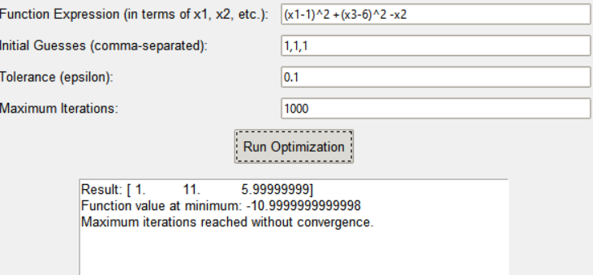
Source Code : CS348-Project

Slide 14
Conclusion
This hybrid optimization technique provides a flexible and robust solution.
By combining Newton-Raphson and gradient descent, the algorithm adapts to challenges dynamically, ensuring that you will have a solution.

Slide 15
Thank You

